Slide 1

Tax Increment Financing (TIF)
Town of Poland
Overview / 101
May 2, 2019

Slide 2

Noreen Norton, M.B.A.
Economic Development Consultant
noreennorton@gmail.com
207.441.0609

Slide 3

Presentation Summary
What is a TIF?
What are the benefits of TIF?
How does a tax shift work?
What types of projects can TIF revenues be used for?
What about Poland TIFs?

Slide 4
So What is a TIF?
TIF stands for “Tax Increment Financing”
TIF Captures the taxes on new investment while protecting the “Original Assessed Value” for the General Fund. The difference is the ‘increment’.
TIF is a LOCAL economic development financing tool
TIF is a flexible finance tool used by municipalities, towns, plantations, and unorganized territories to leverage new property taxes generated by a specific project or projects.

Slide 5
Purpose of TIF
Economic Development or “Municipal” TIF
Created to promote new development to:
Provide new employment opportunities;
Improve and broaden the tax base; and
Improve the general economy of the State.
Short of municipal bonding, TIF is the only locally controlled tool for economic development.

Slide 6
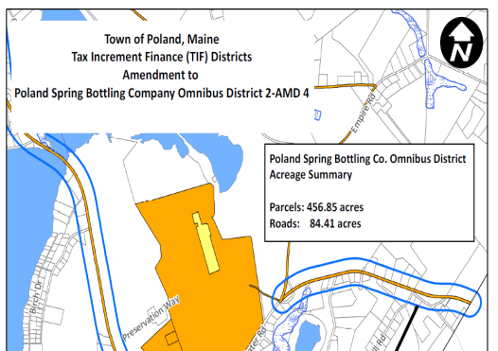
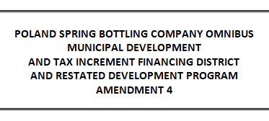
Components of a TIF
Defined Geographic Boundary
where?
Development Program
what?
Financial Plan
how much?

Slide 7
Why Pursue TIF?
Municipality
Developer / Company
Means of funding economic development efforts;
Tool for attracting investment, thus increasing tax base;
Control of performance standards related to project;
Protects from loss of state revenue sharing (tax shift)
Via credit enhancement, TIF provides:
An annual revenue stream;
Increases profitability of the project;
An aid in securing financing;
Effectively reduces the property tax burden

Slide 8


Tax Shift

Slide 9
How Economic Development Works Without a TIF
Municipal assessed value is used to compute:
    General Purpose Aid to Education
    State Revenue Sharing
    County Taxes
When valuation increases, is a decrease in Education Subsidy and Municipal Revenue Sharing and an increase in County Tax obligations.
This means that new tax revenues resulting from a development project must fund lost subsides and increased County taxes.

Slide 10
$$ How TIF Works $$
$
All Taxes on Project Value goes to the General Fund
$ New Value “Sheltered”
TAXES go to fund TIF-eligible projects
V a l u a t i o n
“Original Assessed Value” of Property goes to “General Fund”
30 Years
TIF Created
TIF Ends

Slide 11

Every New Tax Dollar – without the TIF
One small town in Maine…
70% Lost Revenue : 3% - Revenue Sharing
55% - School Aid
12% - County Tax
Available for Municipal Use

Slide 12
Every New Tax Dollar – with the TIF
No Lost Revenue
(assumes 100% TIF)

Slide 13
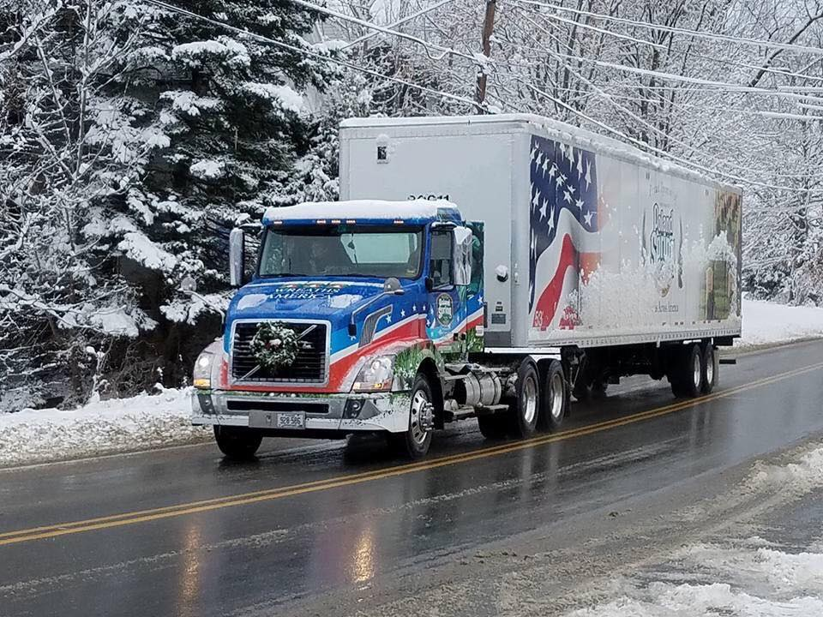
Poland TIFs
Poland Spring Bottling Company District 1 (TIF 1)
Poland Spring Bottling Company District 2 (TIF 2)
Downtown Village District (DTV)

Slide 14
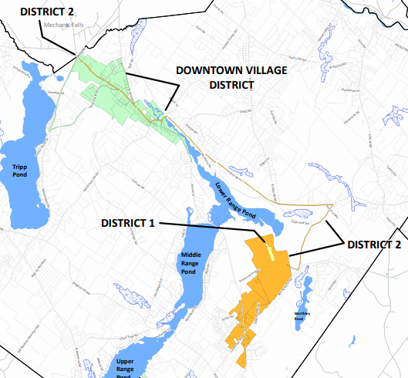
Poland TIFs

Slide 15
Eligible Project Costs
Costs of improvements made within the tax increment financing district.
Costs of improvements that are made outside the TIF district but are directly related to or made necessary by the district.
Costs related to economic development, environmental improvements, fisheries and wildlife or marine resources projects, recreational trails or employment training within the municipality.

Slide 16
Poland Use of TIF Revenues
Infrastructure:
Scenic turnouts, signs, railing and other related improvements in public ways
Public safety measures such as turning lanes, road widening installation of turning lanes, signalization, or other traffic control

Slide 17

Poland Use of TIF Revenues
Costs to mitigate any adverse impact of the district upon the Town
Construction of public improvements such as water and/or sewer extensions

Slide 18

Poland Use of TIF Revenues
Economic Development:
Events that will attract visitors to the municipality
Dues to organizations that provide economic development support to the Town, such as the Androscoggin Valley Council of Governments
Addition of ability to provide loan guarantees and/or grants in addition to revolving loan fund capacity

Slide 19

Poland Use of TIF Revenues
Economic Development (cont.):
Job training for jobs created or retained within Poland, including instate scholarships or online learning entities when necessary. May include broadband service to improve access to training and educational opportunities

Slide 20
Poland Use of TIF Revenues
Other:
Environmental projects
Child care facilities and staffing
Recreational trails
Transit projects
Match for applicable State and Federal grant applications
Provide credit enhancements to encourage business investment

Slide 21
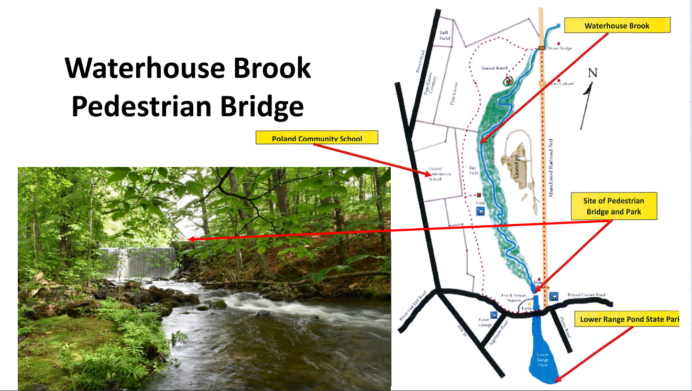
Potential TIF Projects

Slide 22
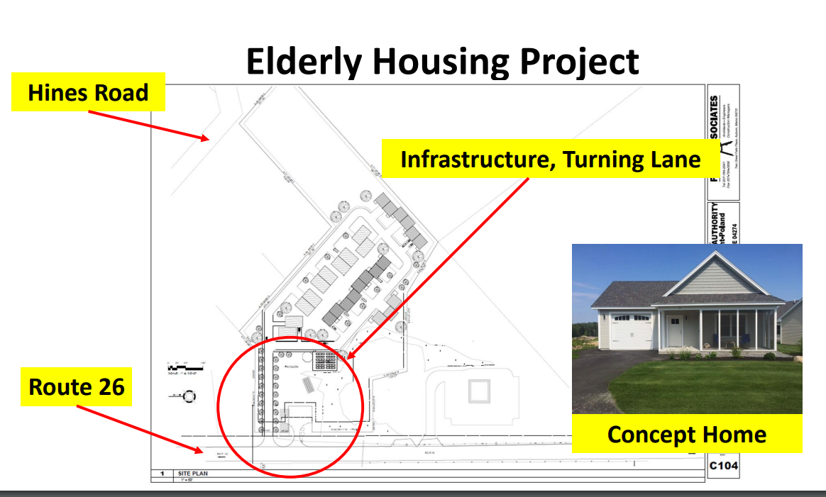
Potential TIF Projects

Slide 23
What is a CEA?
(Credit Enhancement Agreement)
Partnership of Poland with a company or developer to secure investment and jobs and increase chances for success;
Provides reimbursement of a portion of the taxes generated by NEW investment to the company or developer to pay project costs directly or to pay debt service on funds borrowed to finance the project.

Slide 24
What is a CEA?
(Credit Enhancement Agreement)
Omnibus feature
Approval up to the balance of the term of the District with up to one hundred percent (100%) reimbursement of future credit enhancement agreements will be at the sole discretion of the Poland Board of Selectpersons following a public hearing with 10 day notice in a local newspaper.

Slide 25
Minimum Procedure for Creating/Amending a TIF District
Public notice
Public hearing
Vote by legislative body (Town Meeting)
    Designation of TIF District
    Development Program for the District
Approval by Commissioner of the Department of Economic and Community Development (DECD)

Slide 26
Questions?
Public Comments.

Slide 27
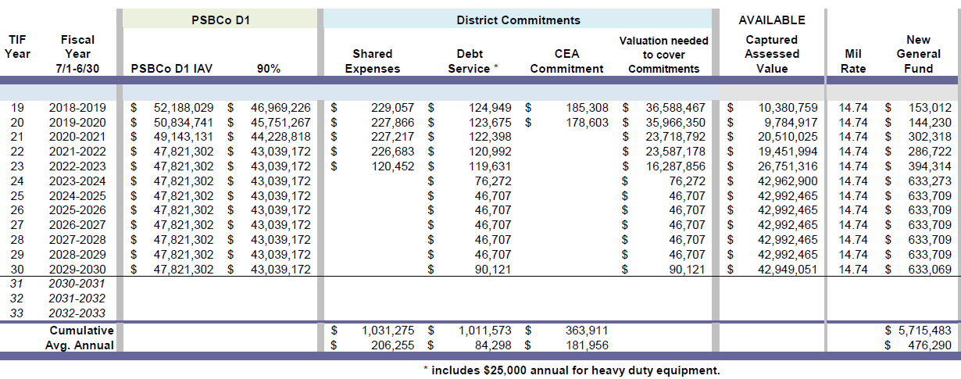
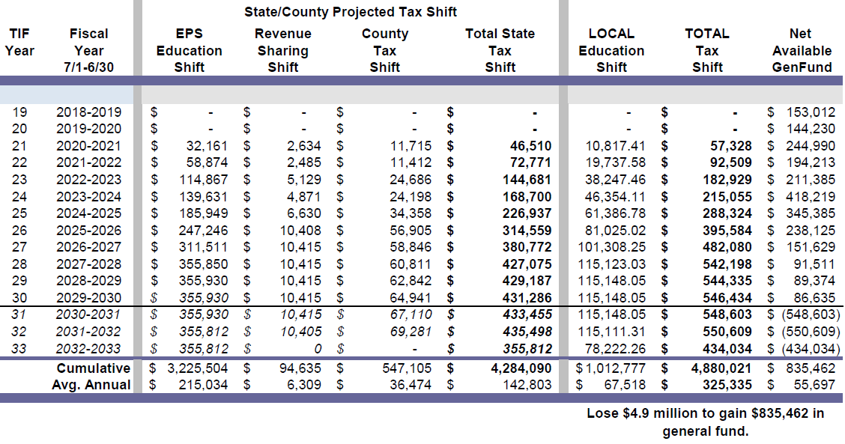

Slide 28
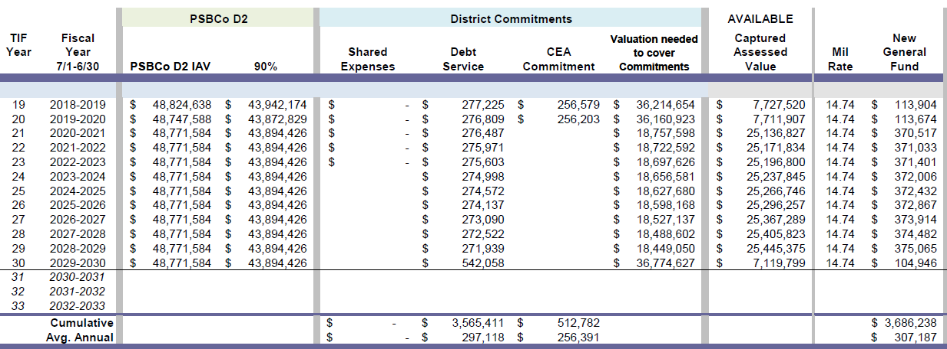
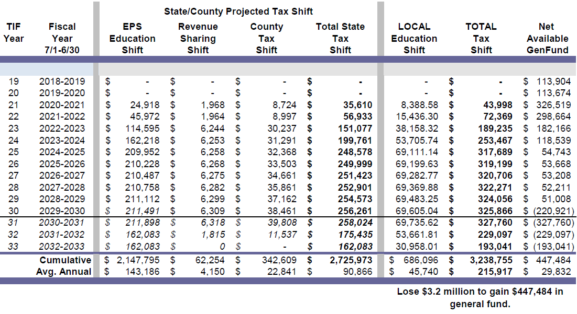

Slide 29
